Slide 1
PROBABILISTIC NEURAL NETWORKS
(PNN)
DR SAYANTAN SINHA

Slide 2
Probabilistic Neural Networks (PNNs) are a scalable alternative to classic back-propagation neural networks in classification and pattern recognition applications. They do not require the large forward and backward calculations that are required by standard neural networks. They can also work with different types of training data. These networks employ the concept of probability theory to minimize the mis-classifications when applied to a classification problem.
A probabilistic neural network (PNN) is a sort of feedforward neural network used to handle classification and pattern recognition problems. In the PNN technique, the parent probability distribution function (PDF) of each class is approximated using a Parzen window and a non-parametric function. The PDF of each class is then used to estimate the class probability of fresh input data, and Bayes’ rule is used to allocate the class with the highest posterior probability to new input data. With this method, the possibility of misclassification is lowered. This type of ANN was created using a Bayesian network and a statistical approach known as Kernel Fisher discriminant analysis.

Slide 3
PNNs have shown a lot of promise in solving difficult scientific and engineering challenges. The following are the major types of difficulties that researchers have attempted to address with PNN:
Labeled stationary data pattern classification
Data pattern classification in which the data has a time-varying probabilistic density function
Applications for signal processing that work with waveforms as data patterns
Unsupervised algorithms for unlabeled data sets, etc.

Slide 4

Parzen Window
The Parzen-window method (also known as the Parzen-Rosenblatt window method) is a popular non-parametric method for estimating a probability density function p(x) for a specific point p(x) from a sample p(xn) that does not require any prior knowledge or assumptions about the underlying distribution.
Let’s look at a simple one-dimensional scenario for a better understanding. The objective is to calculate the PDF p(x) at the given position x. This necessitates determining the number of samples Nh within the interval [x – h,x + h], then dividing by the total number of feature vectors M and the interval length 2h. We’ll get an estimate for the PDF at x using the specified approach.

Slide 5
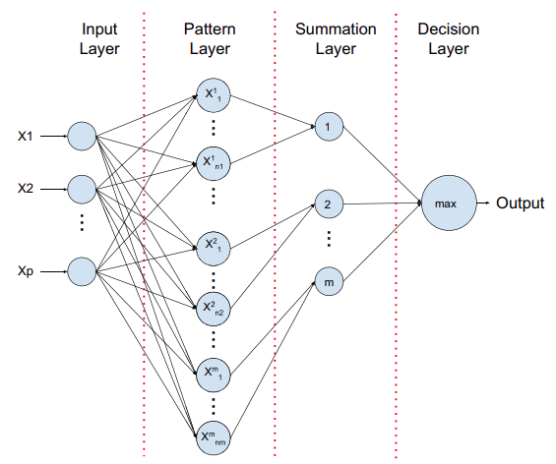

Slide 6
Algorithm of Probabilistic Neural Network
The training set’s exemplar feature vectors are provided to us. We know the class to which each one belongs. The PNN is configured as follows.
Input the file containing the exemplar vectors and class numbers.
Sort these into K sets, each of which contains one class of vectors.
Create a Gaussian function centered on each exemplar vector in set k, and then define the cumulative Gaussian output function for each k.
After we’ve defined the PNN, we can feed vectors into it and classify them as follows.
Read the input vector and assign the Gaussian function according to their performance in each category.
For each cluster of hidden nodes, compute all ‘Gaussian functional useful values’ at the hidden nodes.
Feed all of the Gaussian functional values from the hidden node cluster to the cluster’s single output node.
For each category output node, add all of the inputs and multiply by a constant.
Determine the most valuable of all the useful values added together at the output nodes.

Slide 7
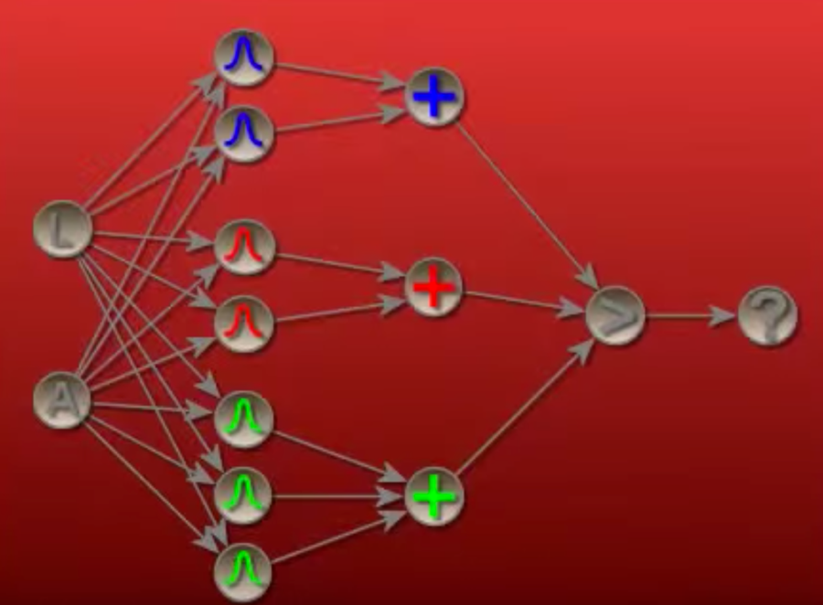

Slide 8
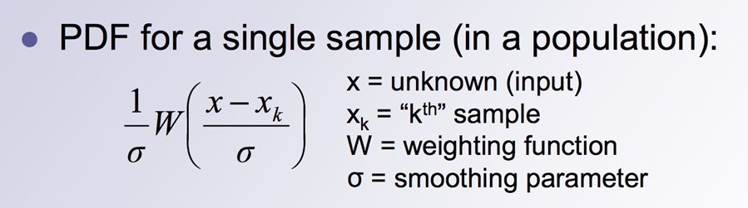
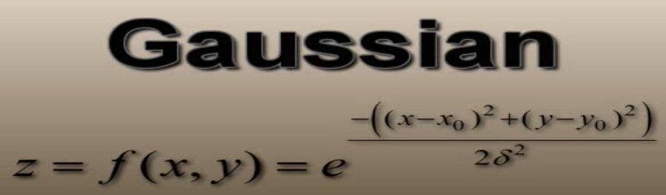

Slide 9
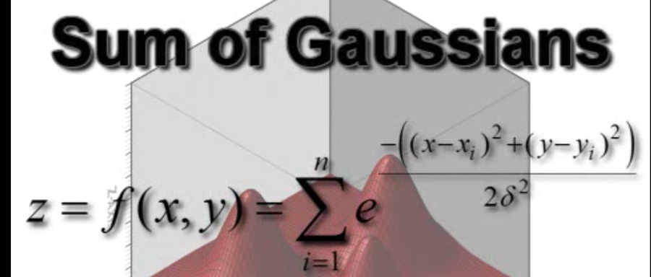

Slide 10
Advantages and Disadvantages of Probabilistic Neural Networks
There are various benefits and drawbacks and applications of employing a PNN rather than a multilayer perceptron.
Advantages
Multilayer perceptron networks are substantially slower than PNNs.
PNNs have the potential to outperform multilayer perceptron networks in terms of accuracy.
Outliers aren’t as noticeable in PNN networks.
PNN networks predict target probability scores with high accuracy.
PNNs are getting close to Bayes’s optimum classification.
Disadvantages
When it comes to classifying new cases, PNNs are slower than multilayer perceptron networks.
PNN requires extra memory to store the mod.

